Slide 1

Environmental Monitoring Systems Using IoT
Martina Nolletti
Michele Intrevado
Giordano Tinella

Slide 2
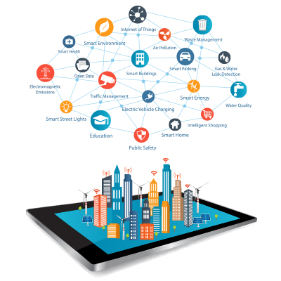
Introduction
Why we need an Environmental Monitoring System?

Slide 3
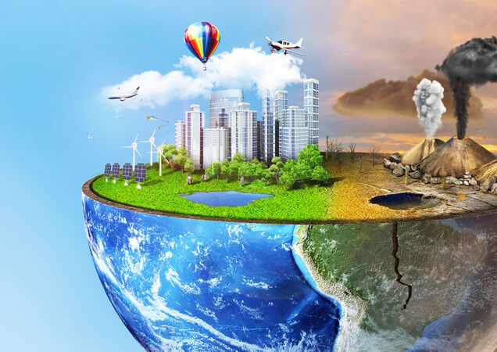

Introduction
How Environment impact our lives?
The consequences of the bad quality environment are:
Destruction of biodiversity;
Scarcity of drinkable water;
Diseases;
Infant mortality.

Slide 4
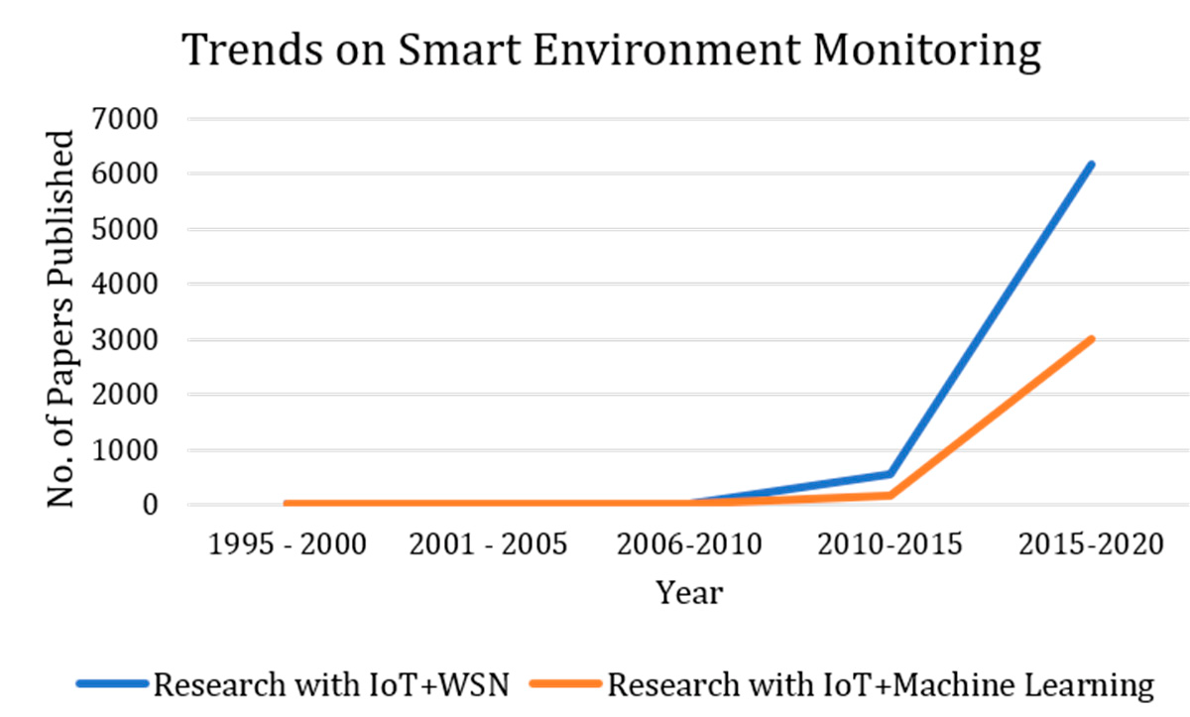
Background

Slide 5
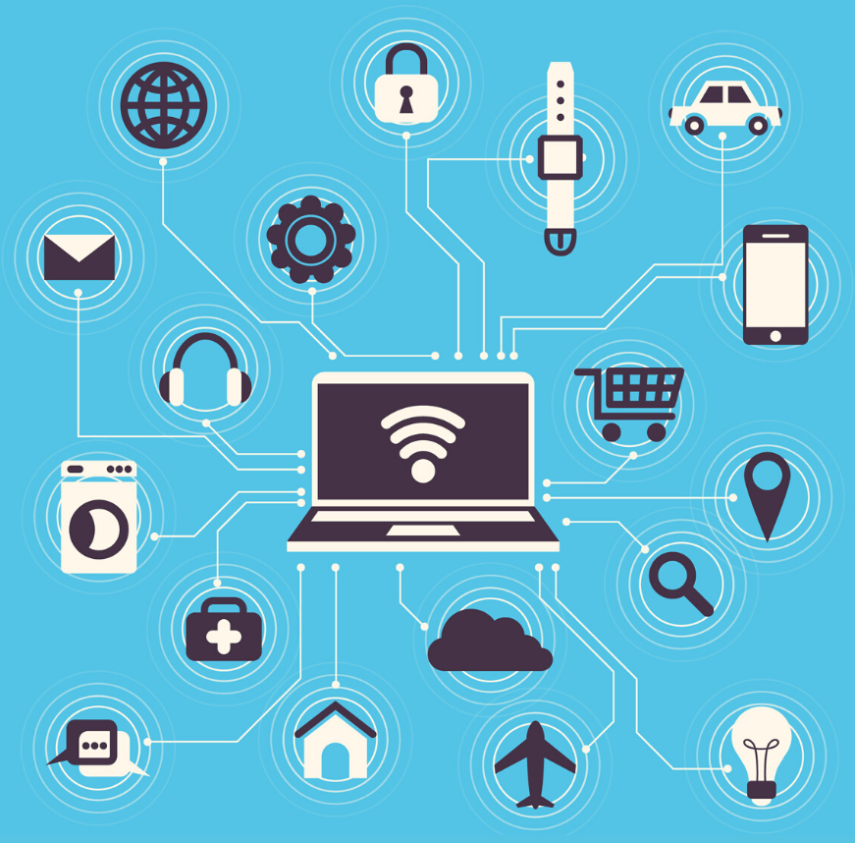
Background
General IoT architecture:
Sensors;
Micro-controller;
Actuators;
Cloud.

Slide 6
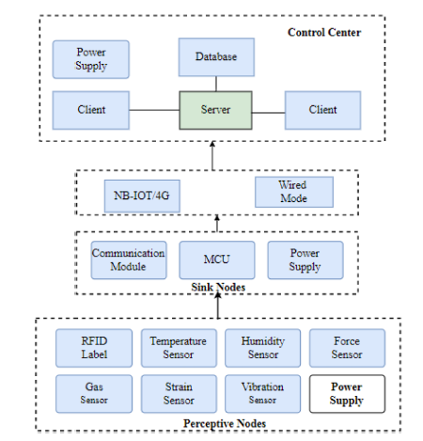
Background
Iot basic architecture:
perception layer;
network communication layer;
application layer.

Slide 7
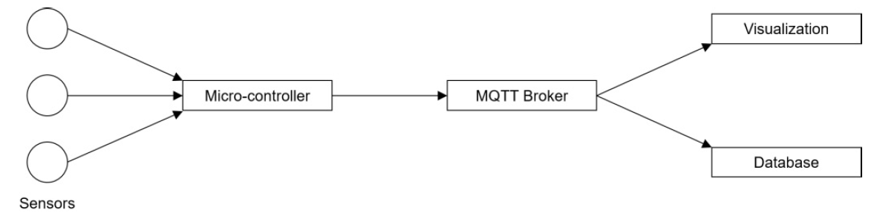
Background
Iot Basic architecture:
Measuring nodes: Micro controllers with sensors;
Message Broker: MQTT;
Data Storage and Visualization.

Slide 8
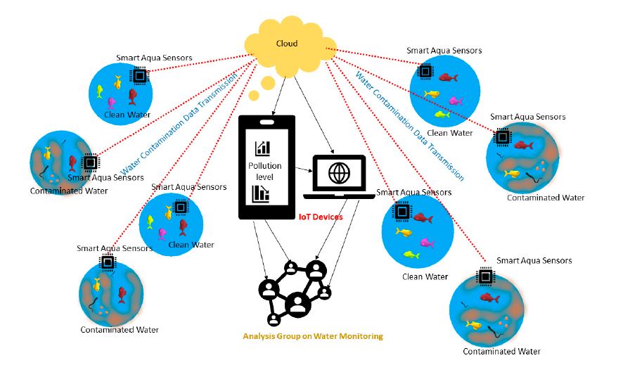
Existing Architecture
Smart environment monitoring system highlighting water contaminations and its monitoring using the cloud connecting internet of things (IoTs) and sensors.

Slide 9
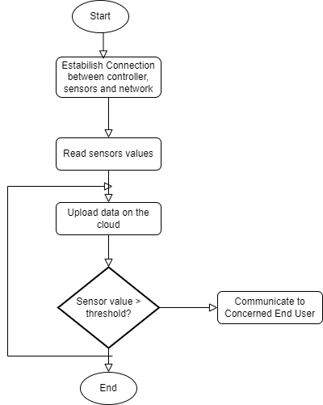
Existing Architecture
Usually IoT Environmental monitoring systems follow this kind of schema, especially IoT-based Smart Water Quality Monitoring Systems.

Slide 10

Observations
The extensive studies brings out the following major observations:
The research on SEM includes various purposes;
The methods are highly divided;
The methods have been used for either classification or prediction.

Slide 11
Problems
The major challenges observed are as follows:
Interoperability;
Sample size;
Noisy data;
Machine learning methods;
No Robust approach to machine learning .

Slide 12
Solutions
The solutions of the problems can be:
Focus on machine learning methods;
A robust set of classification and prediction;
Suitable denoising methods;
Data deduplication approaches;
SEM aims at sustainable development;
Developing suitable standards and protocols.

Slide 13
Conclusion
Environmental pollution is a major threat to any country, as it affects health, and the economy and spoils bio-diversity.
Several studies have already proven that the environmental conditions in the production area strongly affect the human performance.
Combining the necessity to incorporate these conditions to realize further improvements of production, the need for an IoT-based monitoring is crucial.

Slide 14
References
Silvia Liberata Ullo; G. R. Sinha. Advances in Smart Environment Monitoring Systems Using IoT and Sensors. 31 May 2020.
Ting Lu; Xiaolong Chen; Wenhao Bai. Research on environmental monitoring and control technology based on intelligent Internet of Things perception. 29th November 2019.
Oliver Mörtha; Matthias Edera; Lukas Holzeggera; Christian Ramsauer. IoT-based monitoring of environmental conditions to improve the production performance. 2020.
Varsha Lakshmikantha; Anjitha Hiriyannagowda; Akshay Manjunath; Aruna Patted; Jagadeesh Basavaiah; Audre Arlene Anthony. IoT based smart water quality monitoring system. 12 August 2021.

